Slide 1
GT samples (9/28)

Slide 2
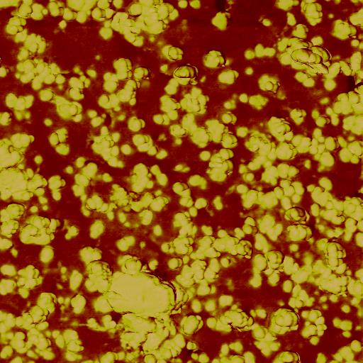
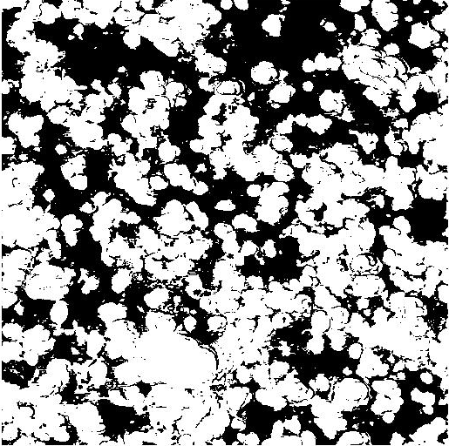
NU35_05um_512pix_Image_R01.000 (VF=0.5774)

Slide 3
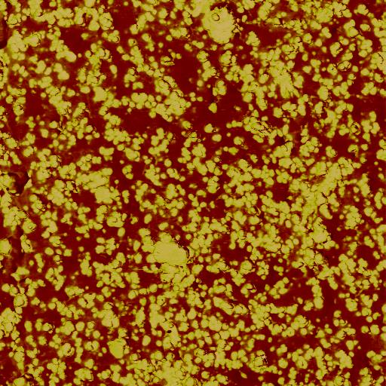
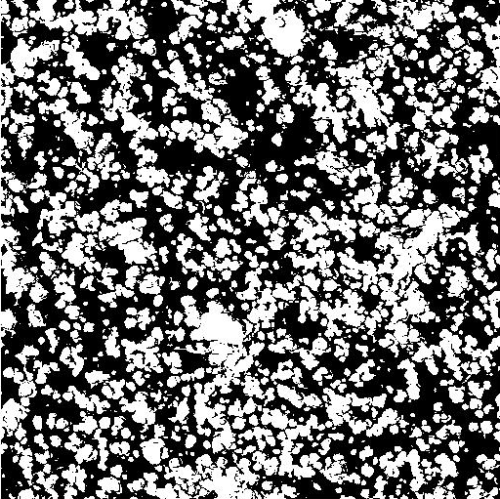
NU35_10um_512pix_Image_R01.001 (Vf= 0.4464)

Slide 4
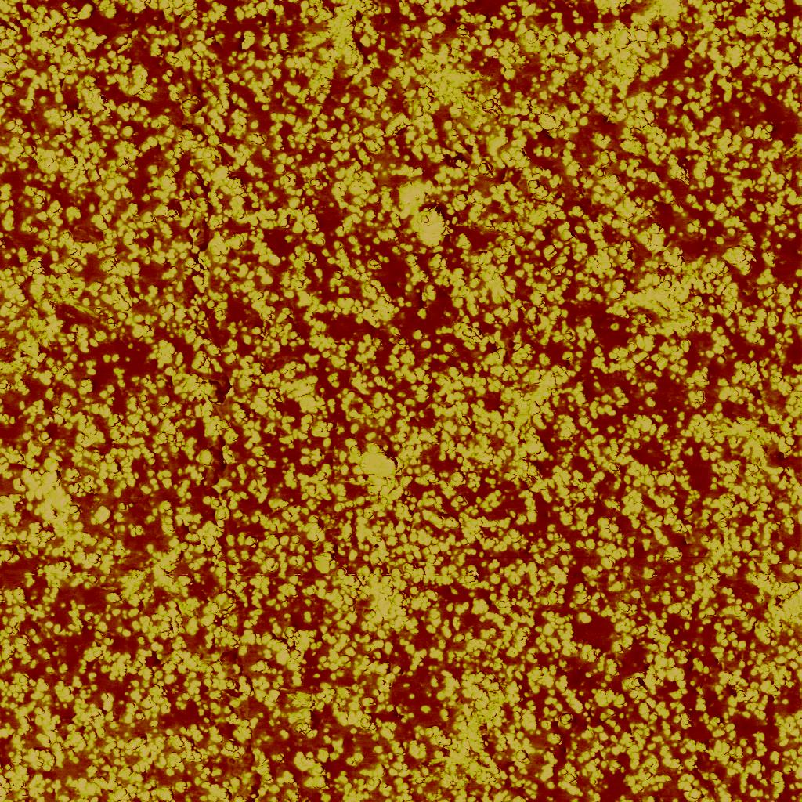
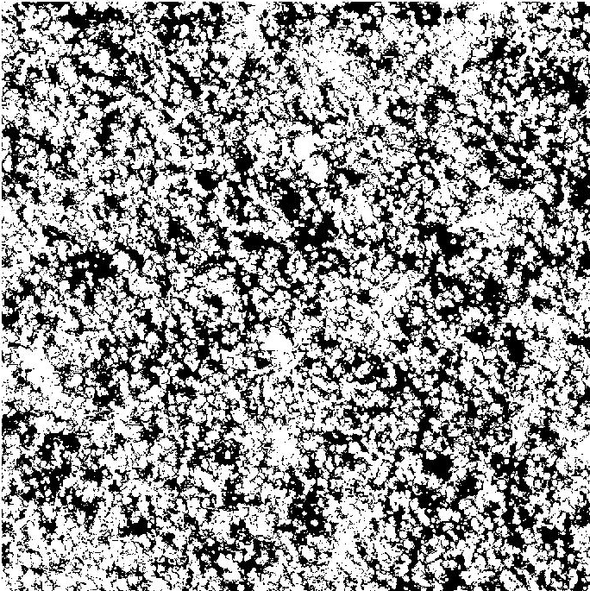
NU35_20um_1024pix_Image_R01.002 (VF=0.5916)

Slide 5
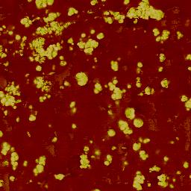
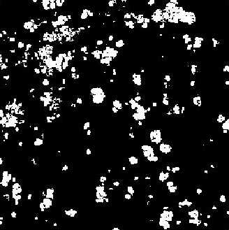
NU37_05um_256pix_Image_R01.000 (VF=0.1189)

Slide 6
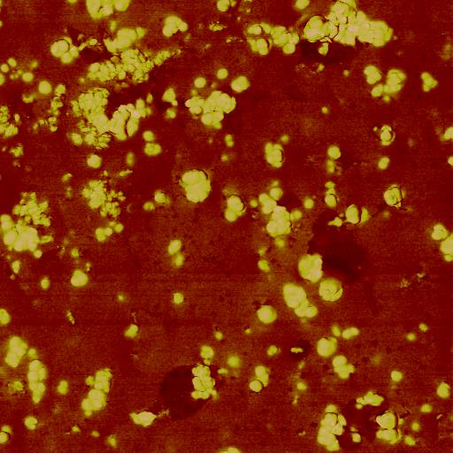
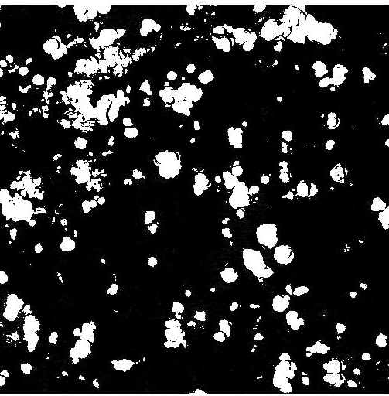
NU37_05um_512pix_Image_R01.001 (Vf=0.1636)

Slide 7
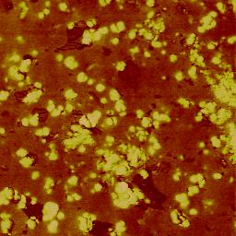
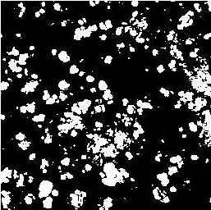
NU37_05um_256pix_Image_R03.000 (Vf=0.1974)

Slide 8
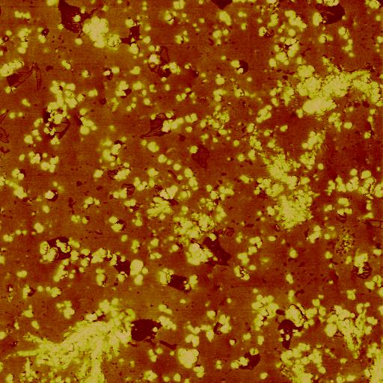
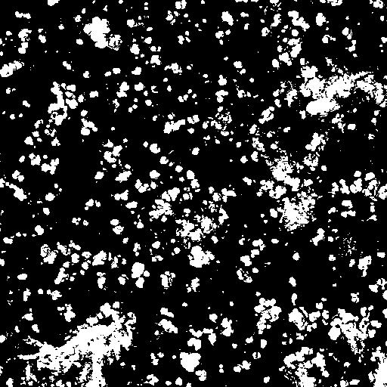
NU37_10um_512pix_Image_R03.001 (Vf=0.1959)

Slide 9
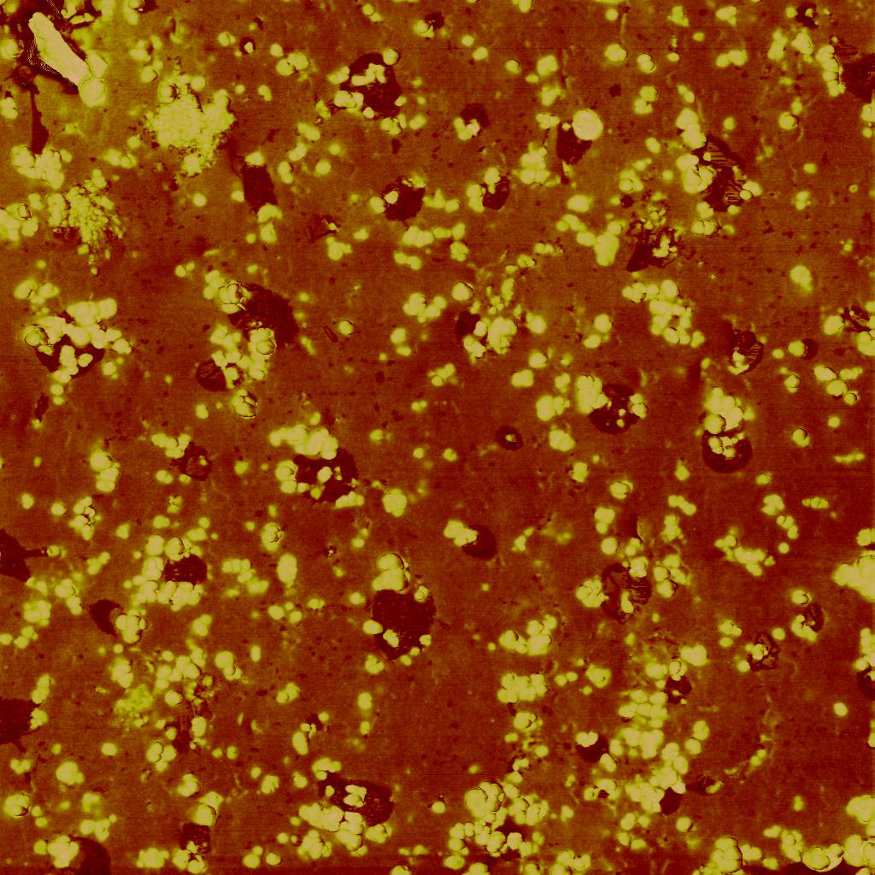
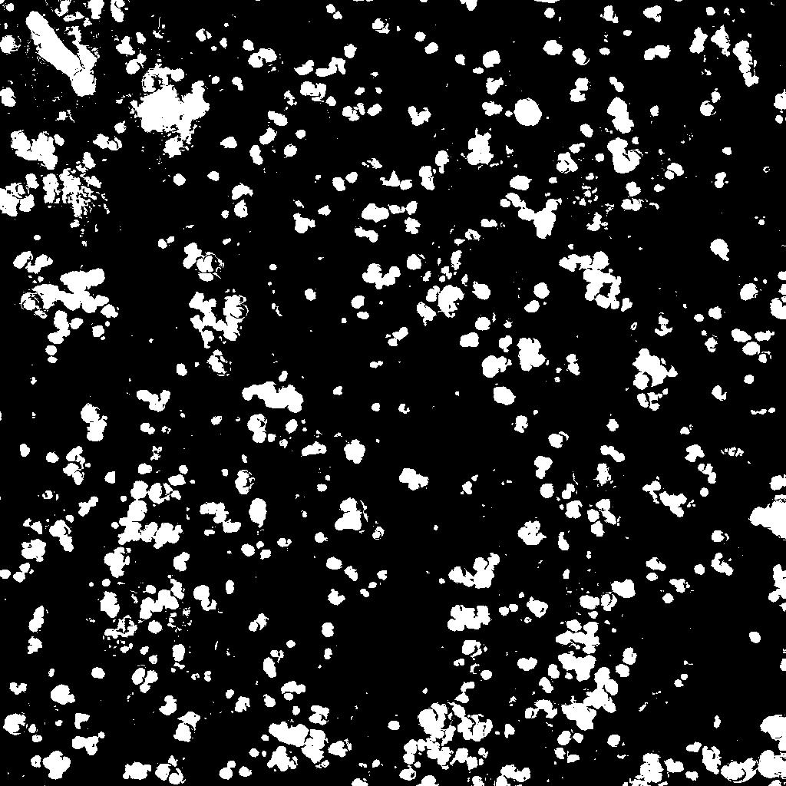
NU37_10um_1024pix_Image_R02.001 (Vf=0.1536)

Slide 10
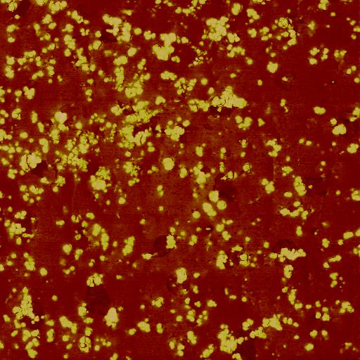
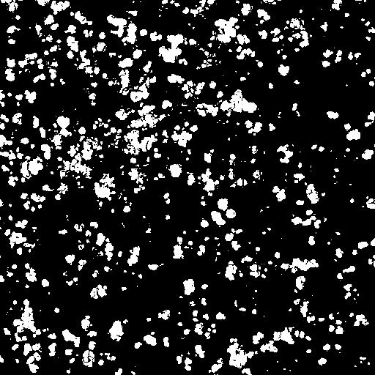
NU37_10um_512pix_Image_R01.002 (Vf=0.1578)

Slide 11
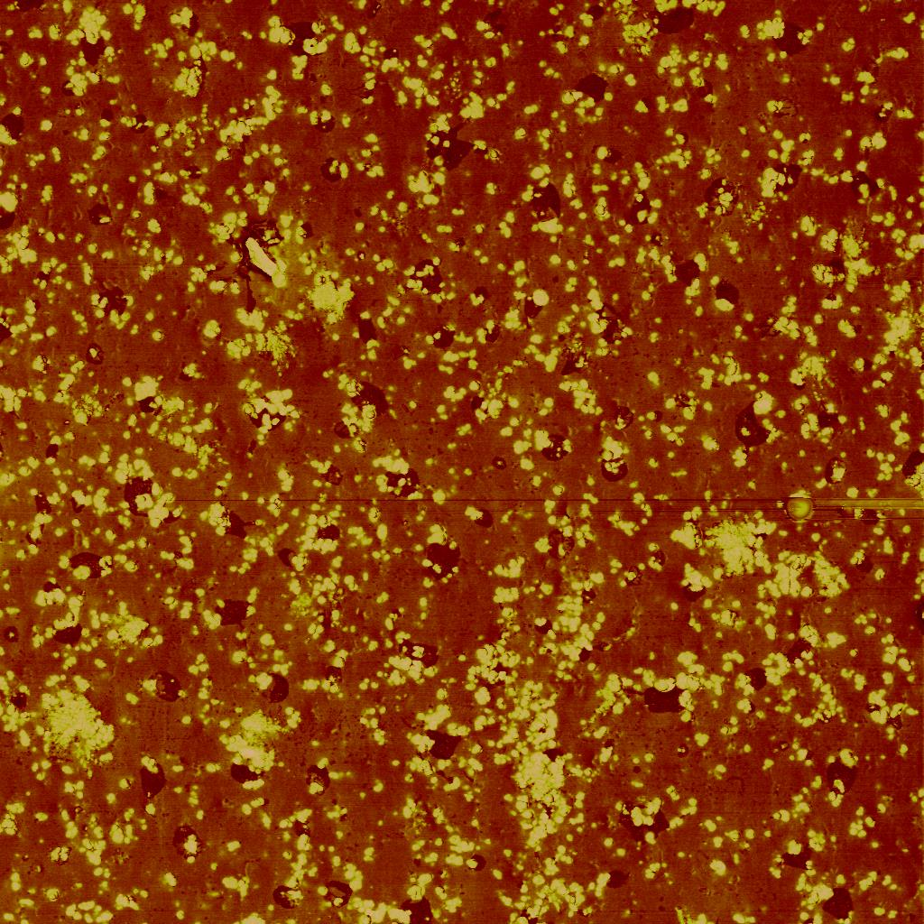
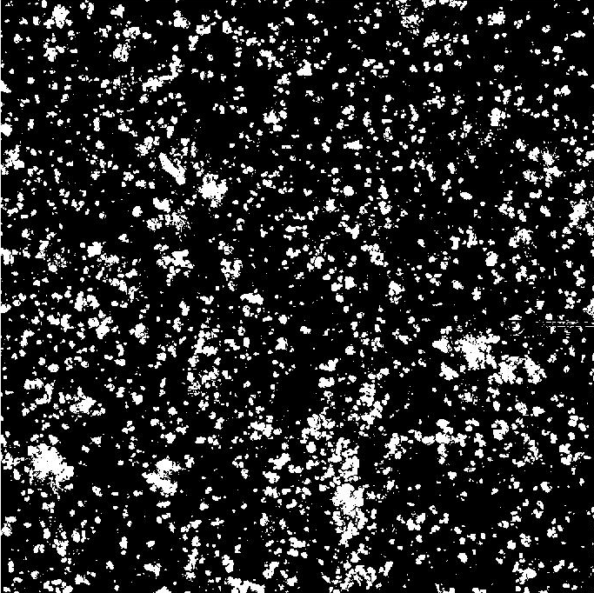
NU37_20um_1024pix_Image_R02.000 (Vf=0.1626)

Slide 12
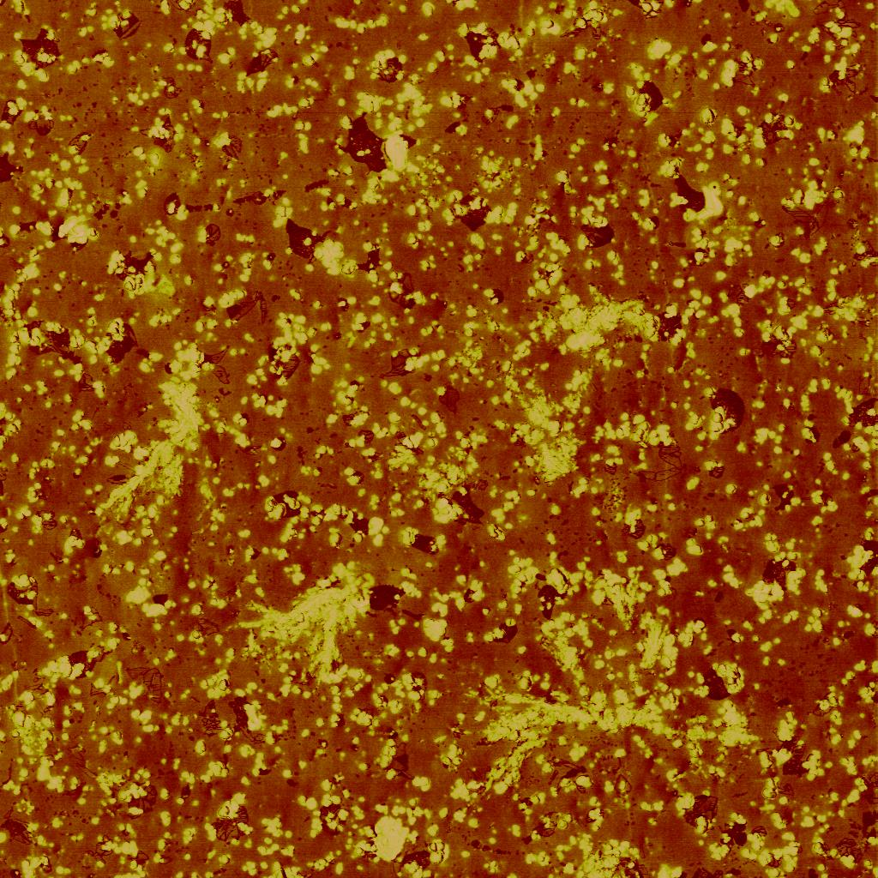
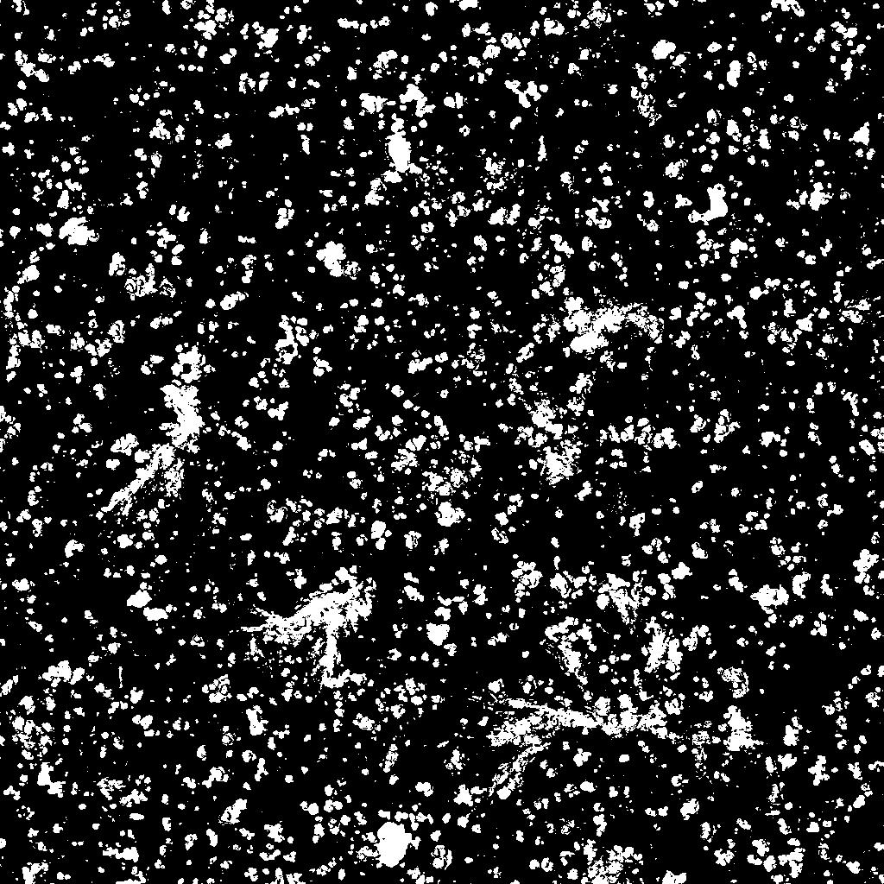
NU37_20um_1024pix_Image_R03.002 (Vf=0.1626)

Slide 13
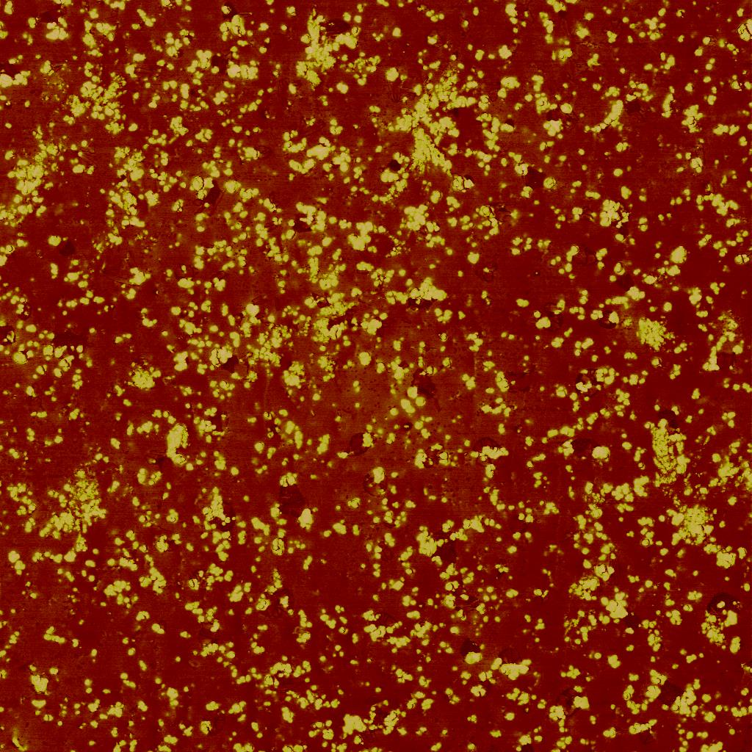
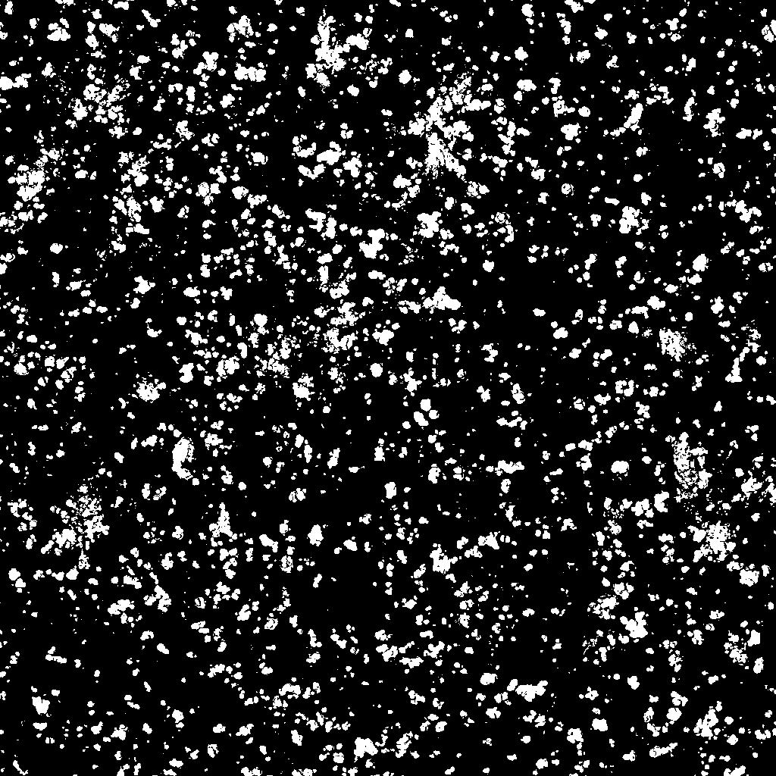
NU37_20um_1024pix_Image_R01.003 (Vf=0.1513)

Slide 14
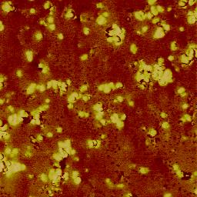
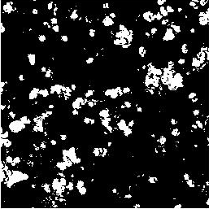
NU38_05um_256pix_Image_R01.001 (Vf =0.1340)

Slide 15
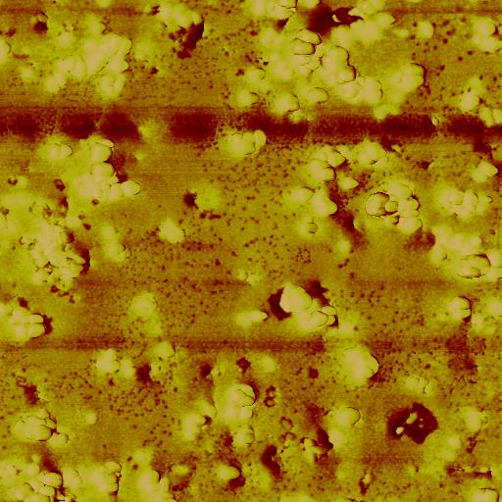
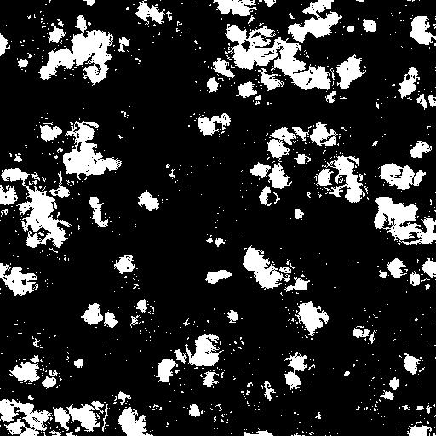
NU38_05um_512pix_Image_R02 (Vf=0.1704)

Slide 16
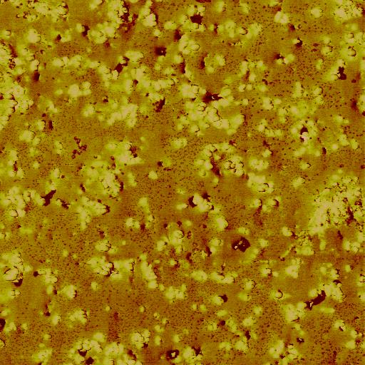
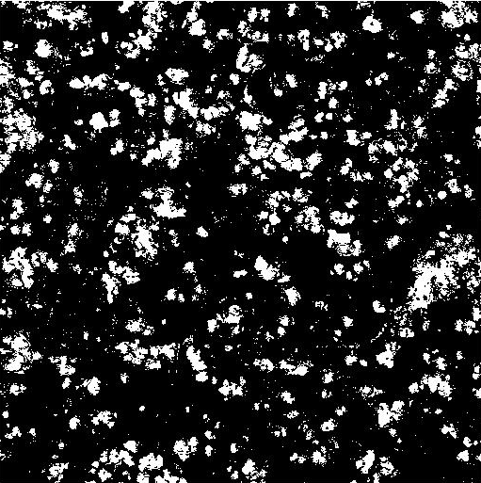
NU38_10um_512pix_Image_R02.001 (Vf=0.1655)

Slide 17
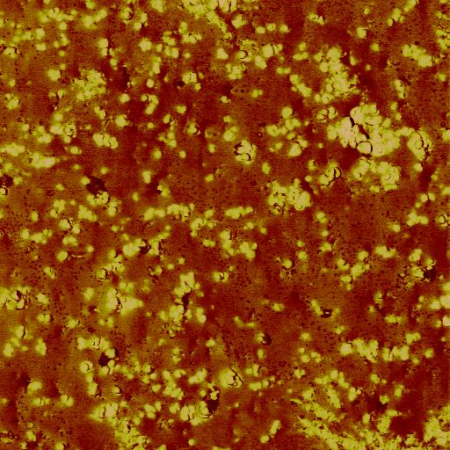
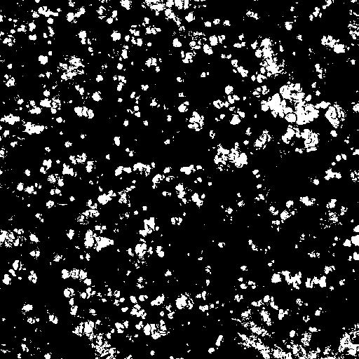
NU3810um_512pix_Image_R01.002 (Vf=0.1448)

Slide 18
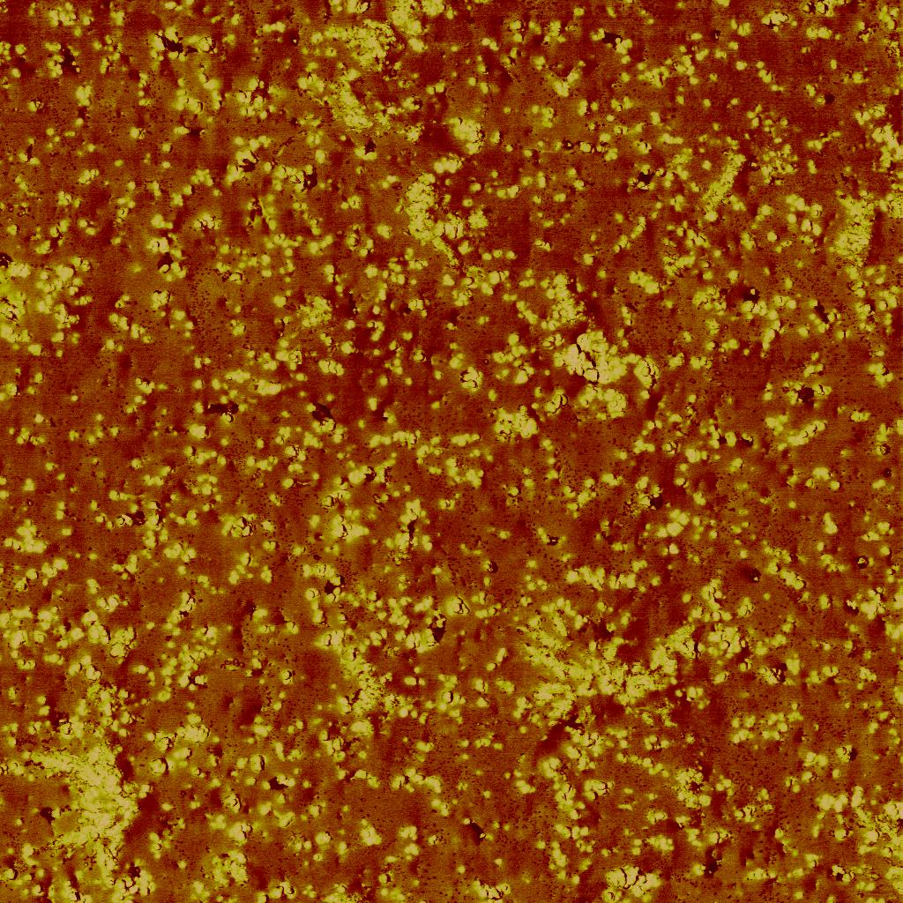
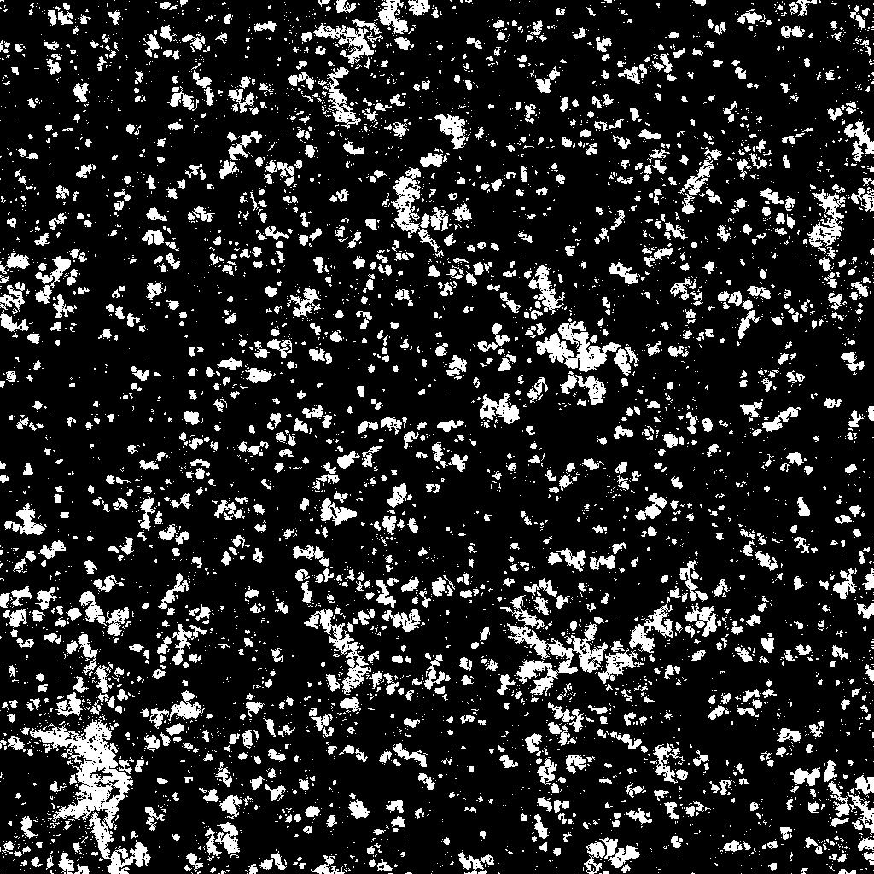
NU38_20um_1024pix_Image_R01.003 (Vf = 0.1536)

Slide 19
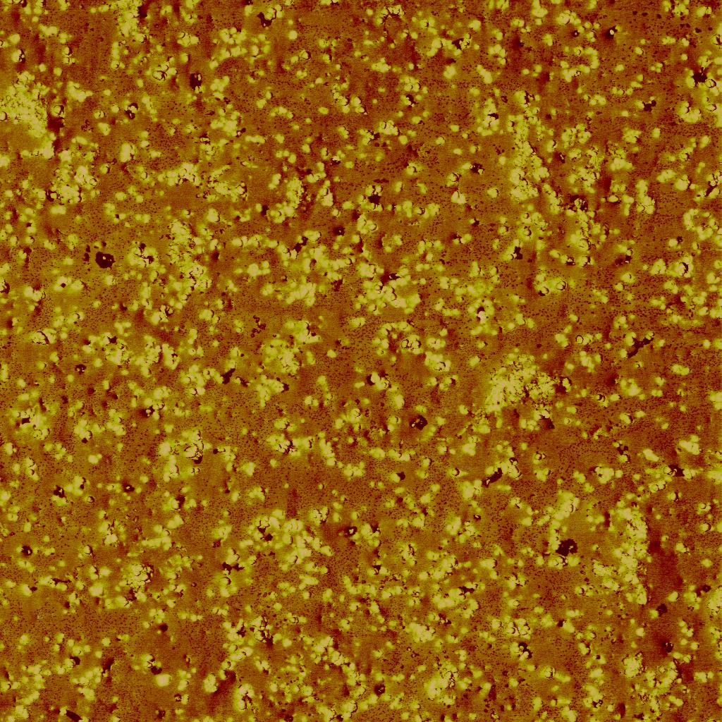
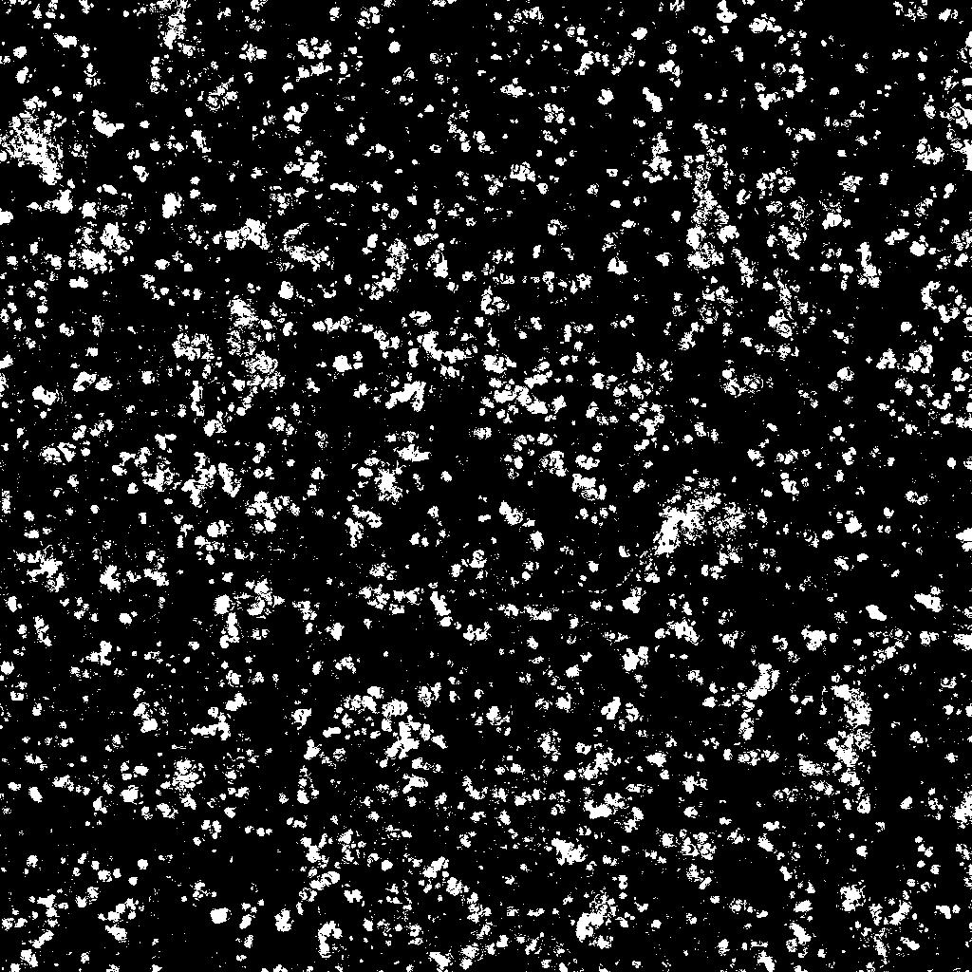
NU38_20um_1024pix_Image_R02.000 (Vf=0.1353)

